Slide 1

Recognizing Nutrient Deficiency in Paddy Crop using Neural Networks
by
K. J. Bharath Kumar
Roll No. 204G1A0520
N. Hari Krishna
Roll No. 214G5A0505
P. Nandini
Roll No. 204G1A0564
M. Gnapika Bai
Roll No. 204G1A0533
Under the guidance of
Mr. P. Veera Prakash M.Tech, (Ph.D), MIEI, MCSI
Assistant Professor & HOD
Department of Computer Science and Engineering
Srinivasa Ramanujan Institute of Technology
(Autonomus)
2023 - 2024

Slide 2

Contents
Abstract
Introduction
Literature survey
Existing System
Proposed System
Planning
Design
Implementation
Conclusion
Research Paper
References

Slide 3
Abstract
In the economic landscape of India, agriculture stands as a pivotal sector encompassing both plant cultivation for food production and the management of domesticated animals. Nutrient management forms a cornerstone of agricultural practices, profoundly influencing crop growth and productivity. Just as with other crops, pests, illnesses, and dietary deficits can affect rice, necessitating continuous advancements in agricultural techniques to bolster output.
In this context, a notable transformation has swept through agriculture, aiming to amplify yields. Focusing on rice, a vital food source, this study captures images of paddy plant leaves, subsequently subjecting them to MobileNetV2 algorithm, a Convolutional Neural Network (CNN) processing. By employing image processing methodologies, a model is constructed to identify various deficiencies present in the leaves. Notably, the proposed approach leverages color and textural characteristics to effectively detect and categorize inadequacies. The integration of CNN technology offers a potent avenue for promptly identifying nutrient insufficiencies within leaves. This proactive identification equips farmers with the information needed to undertake timely corrective measures. Ultimately, this research contributes to the evolution of agriculture by facilitating the detection and rectification of nutrient-related challenges, thereby fostering improved crop health and overall agricultural productivity

Slide 4
Introduction
Agriculture, as the backbone of our economy, faces persistent challenges, and among them, nutrient deficiency in paddy crops remains a critical concern impacting global food security. In an era where technological advancements are reshaping industries, this project introduces a pioneering solution for early detection of nutrient deficiencies in paddy crops using neural networks.
Traditional methods of nutrient assessment often fall short in terms of accuracy and timeliness, hindering farmers from implementing timely corrective measures. Leveraging the power of convolutional neural networks (CNNs), this project aims to revolutionize the way we monitor crop health. The neural network will be trained on a diverse dataset of paddy crop images, allowing it to learn intricate patterns associated with various nutrient deficiencies.
By providing a real-time, non-invasive, and accurate means of identifying nutrient deficiencies, the project aligns with the principles of precision agriculture. The user-friendly interface ensures accessibility for farmers, empowering them with actionable insights. The scalability and adaptability of the solution are designed to cater to diverse agricultural landscapes, contributing to the global effort to enhance agricultural productivity sustainably. This project serves as a bridge between technology and agriculture, promising to transform crop management practices and contribute to a more food-secure future.

Slide 5
Literature Survey
s.no | Publisher/Journal | Title | Authors Name | Year of Publication | Summary of the paper
[1] | International Journal of Recent Technology and Engineering (IJRTE) | Machine Learning Based Nutrient Deficiency Detection in Crops. | 1.Amritha T 2.Gokulalakshmi T 3.Umamaheshwari P 4.T Rajasekar | 2020 | This research Machine Learning Based Nutrient deficit detection in crops attempts to create an automated robotic vehicle that identifies nutrient deficit in crops just by collecting an image of the crop plants leaves. The captured images is then processed by using the convolutional neural networks (CNN).
Algorithms | DataSets | Improvements
CNN model along with Canny operator. | --- | The amount of fertilizer for the corresponding nutrient deficiency is also displayed. Thus, entire agricultural work can be integrated in a single system.
Additional Summary

Slide 6
Literature Survey
s.no | Publisher/Journal | Title | Authors Name | Year of Publication | Summary of the paper
[2] | ICIC Express Letters | PLANT NUTRIENT DEFICIENCY USING DEEP CONVOLUTIONAL NEURAL NETWORKS. | 1.Lili Ayu Wulandhari 2.Alexander Agung Santoso Gunawan 3.Arie Qurania 4.Prihastuti Harsani 5.Triastinurmiatiningsih Ferdy Tarawan 6.Riska Fauzia Hermawan | 2019 | This paper proposes a deep convolutional neural network to diagnose condition based on image of plants. The experimental results show that fine tuning approach achieves the best accuracy, namely 96% and 86% for training and testing.
Algorithms | DataSets | Improvements
CNN model along with Inception-Resnet architecture | ImageNet Dataset | The model is re-trained using okra plant images data. A few experiments are conducted by changing the hyperparameter such as learning rate and epochs.
Additional Summary

Slide 7
Literature Survey
s.no | Publisher/Journal | Title | Authors Name | Year of Publication | Summary of the paper
[3] | Auckland University of Technology | The Comprehension Review on Detection of Macro Nutrients Deficiency in Plants based on the Image processing Technique. | 1.Lia Kamelia 2.Titik Khawa Binti Abdul Rahman 3.Hoga Saragih 4.Reni Haerani | 2020 | This paper discusses various methods used in the detection of nutrient deficiencies in plants based on visual images. This research will support the growth of agriculture automation equipment and system in more approaches
Algorithms | DataSets | Improvements
PSNR, MSE, RMSE | - | The image acquisition will use the smartphone camera to facilitate the farmers identifying the nutrient deficiency symptoms.
Additional Summary

Slide 8
Literature Survey
s.no | Publisher/Journal | Title | Authors Name | Year of Publication | Summary of the paper
[4] | Total Environement Research themes | Protecting the environment from pollution through early detection of infections on crops using deep belief network in paddy. | 1.A. Pushpa AthisayaSakila Rani 2.N. Suresh Singh | 2022 | This study proposes an automatic classification system using artificial intelligence and image processing. The proposed work provide a specificity, precision, sensitivity, F1-score and accuracy of 97.1%, 97.6%, 96.2%, 96.8% and 98.1%.
Algorithms | DataSets | Improvements
AI & ML | Kaggle data set | Precise identification of reasons for infection allows farmers to use specific control methods with less toxic chemicals or through eco-friendly methods.
Additional Summary

Slide 9
Literature Survey
s.no | Publisher/Journal | Title | Authors Name | Year of Publication | Summary of the paper
[5] | IEEECON | Identification of plant nutrient deficiencies using convolutional neural networks. | 1.Ukrit Watchareerutai 2.Pavit Noinongyao 3. Chaiwat Wattanapaiboonsuk 4. Puriwat Khantiviriya 5. Sutsawat Duangsrisai | 2018 | This study proposes a method divides an input leaf image into small blocks. The results indicate the superiority of the proposed method over trained humans in nutrient deficiency identification.
Algorithms | DataSets | Improvements
CNN, Machine Learning | A dataset consisting of 3000 leaf images was collected and used for experimentations. | Next step include but not limit to further analysis on the time factor. Other factors including nutrient mobility and leaf age etc which can affect the symptoms would also be considered to improve reliability of identification.
Additional Summary

Slide 10
Literature Survey
s.no | Publisher/Journal | Title | Authors Name | Year of Publication | Summary of the paper
[6] | International Research Journal of Engineering and Technology (IRJET) | Detection of nutrient deficiencies in crops using support vector machines (SVM). | 1.Vijay J. Kadam 2. T. B. Mohite-Patil | 2022 | This study proposes to build a model to detect various types of deficiencies in the leaves. The proposed system presents an effective method for detecting using colour-texture analysis and k-means clustering
Algorithms | DataSets | Improvements
Colour-texture analysis, K-means clustering | - | Segmentation training and classification and finally identification. This project proposes a valuable approach which supports the accurate detection of nutrients which are deficient in the plant leaves.
Additional Summary

Slide 11
Existing System
The current approaches to monitoring nutrient deficiency in paddy crops primarily rely on traditional methods such as soil testing and visual inspection by agricultural experts. Soil testing involves collecting soil samples, conducting laboratory analyses, and providing farmers with nutrient content recommendations. Visual inspection, on the other hand, relies on the expertise of agricultural professionals who visually assess the crop's health based on symptoms of nutrient deficiencies. While these methods have been longstanding practices, they exhibit several limitations.
Disadvantages:
Time-Consuming Process: Traditional methods, particularly soil testing, are time-consuming. Farmers need to wait for laboratory results, leading to delays in identifying and addressing nutrient deficiencies promptly.
Labor-Intensive: Visual inspection requires the presence of skilled agricultural experts, making it labor-intensive and impractical for widespread adoption. The availability of such experts may be limited, especially in remote or rural areas.
Limited Precision: Visual inspection relies on human judgment, which may lack the precision needed to identify subtle signs of nutrient deficiencies. This can result in misdiagnosis and ineffective corrective measures.
Invasive Soil Sampling: Soil testing involves invasive soil sampling procedures. Collecting samples can be disruptive to the soil structure and may not accurately represent the entire field, leading to inaccuracies in nutrient assessments.
Lack of Real-Time Monitoring: The existing system lacks real-time monitoring capabilities, preventing farmers from receiving instant feedback on the nutritional status of their crops. This hinders timely decision-making and corrective actions to optimize crop health.

Slide 12
Proposed System
The proposed system aims to revolutionize nutrient deficiency detection in paddy crops by introducing an innovative approach leveraging neural networks, specifically convolutional neural networks (CNNs). The system involves the analysis of images captured from paddy fields, enabling the automatic identification of subtle signs indicative of nutrient deficiencies. The neural network is trained on a diverse dataset, allowing it to learn complex patterns associated with various nutrient deficiencies. The user-friendly interface facilitates seamless interaction, allowing farmers to upload images and receive instant reports on their crops' nutritional status. Unlike the existing system, the proposed approach offers a non-invasive, real-time, and accurate solution to nutrient deficiency monitoring.
Advantages:
Real-Time Monitoring: The proposed system provides real-time monitoring capabilities, allowing farmers to receive instant feedback on the nutritional status of their paddy crops. This enables timely decision-making and corrective actions.
Non-Invasive: Unlike traditional soil testing methods, the proposed system does not require invasive soil sampling. It relies on non-invasive image analysis, minimizing disruption to the soil structure and preserving crop health.
High Precision: Leveraging the power of CNNs, the system achieves high precision in identifying subtle signs of nutrient deficiencies. This ensures accurate and reliable detection, reducing the likelihood of misdiagnosis.
User-Friendly Interface: The system features a user-friendly interface accessible to farmers, facilitating easy image uploads and interpretation of nutrient deficiency reports. This promotes widespread adoption, even in areas with limited technical expertise.
Scalability: The proposed system is designed to be scalable and adaptable to various agricultural settings. It can accommodate different environmental conditions and agricultural practices, making it applicable on a global scale and contributing to sustainable crop management practices.

Slide 13
Proposed System
The Objectives of this proposed system are:
Neural Network Implementation: Develop a neural network model, primarily based on CNNs, to effectively process and classify images of paddy crops for signs of nutrient deficiency.
Dataset Compilation: Collect and curate a comprehensive dataset of paddy crop images with diverse nutrient deficiency scenarios to train and validate the neural network.
Real-time Detection: Implement a real-time nutrient deficiency detection system capable of analyzing images captured from paddy fields, providing instant insights to farmers.
User-Friendly Interface: Design an intuitive user interface accessible to farmers, allowing them to easily upload images and interpret nutrient deficiency reports generated by the system.

Slide 14
Planning
Objective
Develop a smart system using CNNs to spot nutrient problems in rice leaves quickly and precisely, aiding farmers in timely corrective actions.
Evaluate the real-world potential of the Deep CNN-based solution to detect nutrient deficiencies in rice crops, enhancing crop health management practices.
Scope: The scope of this project encompasses the development and implementation of an innovative solution for recognizing nutrient deficiencies in paddy crops using advanced neural networks. The project will focus on creating a robust system capable of analyzing images of paddy fields to detect subtle signs of nutrient deficiencies. The scope extends to the integration of convolutional neural networks (CNNs) for accurate image classification, allowing farmers to receive prompt and reliable information about the nutritional status of their crops. Additionally, the project aims to explore the scalability and adaptability of the solution to various agricultural settings, ensuring its usability across diverse geographic regions.

Slide 15
Planning
Functional Requirements
Image Upload and Processing:
The system should allow users (farmers) to upload images of paddy crops through a user-friendly interface.
Implement image processing functionalities to preprocess the uploaded images for optimal analysis.
Neural Network Integration:
Integrate a convolutional neural network (CNN) into the system for image analysis.
Train the neural network on a diverse dataset containing images of paddy crops with varying nutrient deficiencies.
Nutrient Deficiency Classification:
Implement algorithms for classifying images based on signs and symptoms of nutrient deficiencies.
Ensure the neural network can accurately identify multiple nutrient deficiencies, including nitrogen, phosphorus, and potassium.

Slide 16
Planning
Real-Time Monitoring:
Enable real-time monitoring of paddy crops by providing instant feedback on nutrient deficiency status.
Implement a notification system to alert users when nutrient deficiencies are detected, allowing for timely corrective actions.
User Interface (UI):
Design a user-friendly interface accessible to users with varying technical expertise.
Include features for image visualization, nutrient deficiency reports, and an intuitive navigation system.
Crop Health Reports:
Generate detailed reports for farmers, highlighting the nutritional status of their paddy crops.
Include insights into the severity of nutrient deficiencies, recommended corrective measures, and historical data for trend analysis.

Slide 17
Planning
Scalability:
Ensure the system is scalable to accommodate varying field sizes and different geographic regions.
Design the architecture to handle an increasing number of users and a growing dataset for continuous improvement.
Data Security:
Implement robust data security measures to protect user-uploaded images and sensitive information.
Ensure compliance with data protection regulations and standards.
User Authentication and Authorization:
Implement secure user authentication mechanisms to verify user identities.
Define role-based access control to restrict access to specific functionalities based on user roles.
Integration with External Systems:
Allow integration with external systems, such as weather databases, to factor environmental conditions into nutrient deficiency assessments.
Facilitate data exchange with other precision agriculture tools for comprehensive crop management.

Slide 18
Planning
Non-Functional Requirements
Performance:
The system should provide fast and responsive performance to deliver real-time monitoring results.
Ensure that image processing and neural network inference are optimized for efficiency.
Reliability:
Design the system to be reliable, minimizing downtime and ensuring continuous availability.
Implement mechanisms for fault tolerance and graceful degradation under high load conditions.
Scalability:
Ensure scalability to handle an increasing number of users, images, and data without compromising performance.
Implement load balancing and distributed computing strategies for scalability.
Usability:
Design an intuitive and user-friendly interface to cater to users with varying levels of technical expertise.
Conduct user testing to gather feedback for continuous improvement in usability.

Slide 19
Planning
Security:
Implement robust security measures to protect user data, especially sensitive images and reports.
Employ encryption protocols for data in transit and at rest to prevent unauthorized access.
Compatibility:
Ensure compatibility with various devices and browsers to accommodate users with different technological preferences.
Conduct cross-browser and cross-device testing for a seamless user experience.
Maintainability:
Develop the system with modular and well-documented code for ease of maintenance.
Implement version control and a systematic update process to introduce new features and improvements

Slide 20
Planning
HARDWARE REQUIREMENTS
Processor - I3/Intel Processor
Hard Disk - 160GB
Key Board - Standard Windows Keyboard
Mouse - Two or Three Button Mouse
Monitor - SVGA
RAM - 8GB
SOFTWARE REQUIREMENTS:
Operating System : Windows 7/8/10
Server side Script : HTML, CSS, Bootstrap & JS
Programming Language : Python
Libraries : Django, Pandas, Mysql.connector, Os, Smtplib, Numpy
IDE/Workbench : PyCharm
Technology : Python 3.6+
Server Deployment : Xampp Server
Database : MySQL

Slide 21
Planning
Methodology
The proposed methodology involves a combination of image processing techniques and deep learning algorithms, particularly Convolutional Neural Networks (CNNs), to detect nutrient deficiencies in paddy crops. The following steps outline the approach.
Dataset Collection:
Gather a diverse dataset of paddy crop images representing various growth stages and nutrient deficiency scenarios. Include images with clear indications of nitrogen, phosphorus, and potassium deficiencies.
The following are the pre-processing steps for the methodology: Preprocessing, Neural Network Architecture, Model Training, Data Augmentation, Hyperparameter Tuning, Validation and Testing, Real-Time Image Analysis, Post-Processing and Reporting.

Slide 22
Planning
System Modules:
Image Processing and Neural Network Integration
Real-Time Image Analysis
Data Storage and Retrieval
User Module:
User Authentication and Authorization
Image Upload Interface
Parameter Configuration
Nutrient Deficiency Reports
Recommendations and Corrective Measures
Historical Analysis and Trends

Slide 23
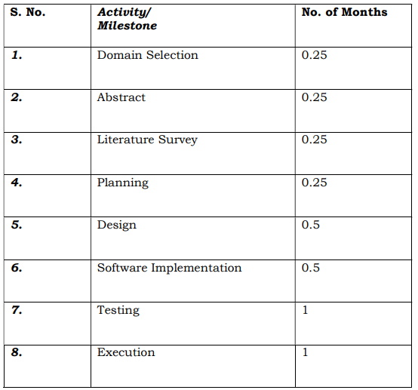
Planning
Work Schedule

Slide 24
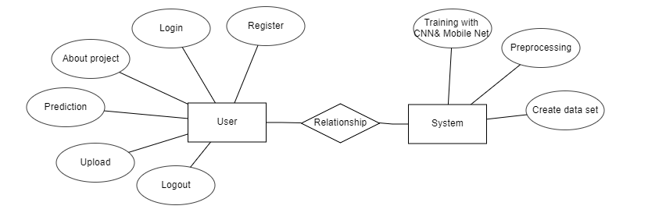
Design-ER Diagram
An Entity–relationship model (ER model) describes the structure of a database with the help of a diagram, which is known as Entity Relationship Diagram (ER Diagram). An ER model is a design or blueprint of a database that can later be implemented as a database. The main components of E-R model are: entity set and relationship set.
An ER diagram shows the relationship among entity sets. An entity set is a group of similar entities and these entities can have attributes. In terms of DBMS, an entity is a table or attribute of a table in database, so by showing relationship among tables and their attributes, ER diagram shows the complete logical structure of a database. Let’s have a look at a simple ER diagram to understand this concept

Slide 25
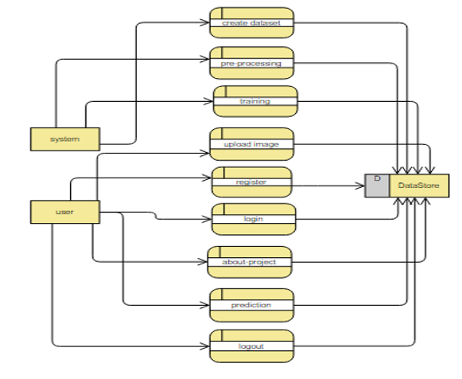
Design-DFD Diagram

Slide 26
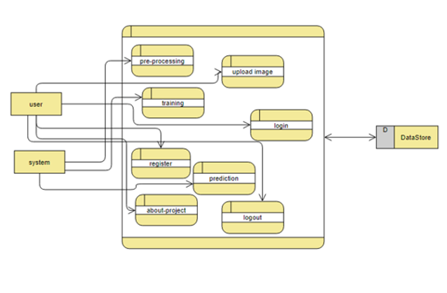
Design-DFD Diagram

Slide 27
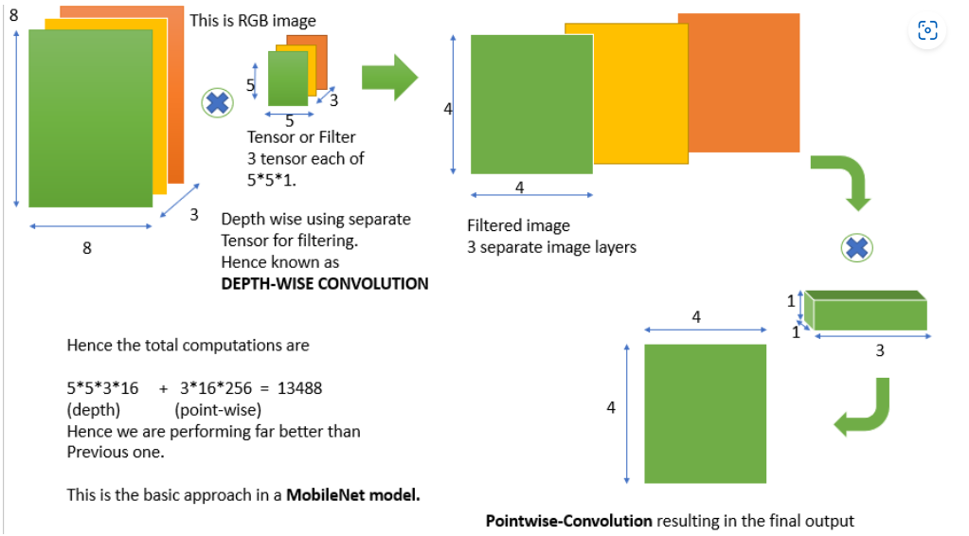
Design- MobileNet Architecture

Slide 28
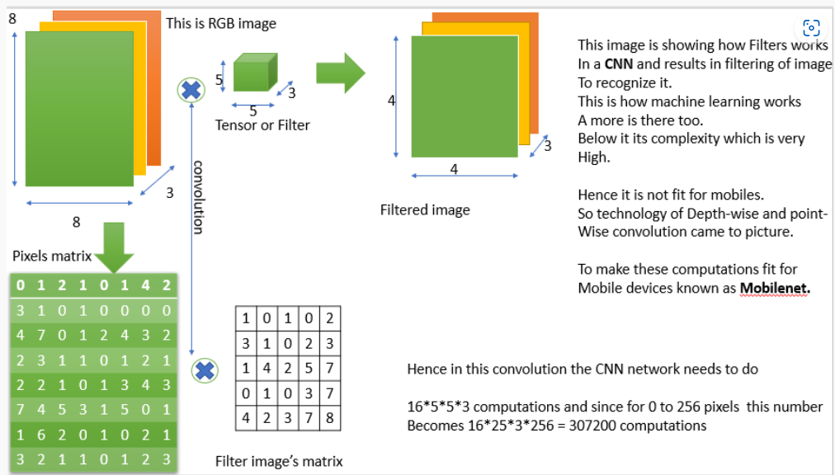
Design-CNN Architecture

Slide 29
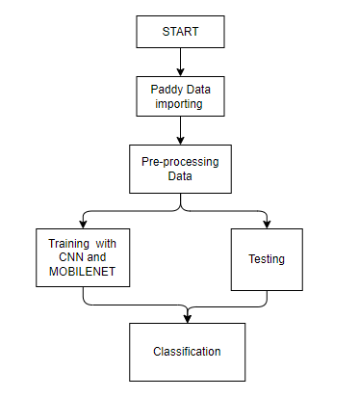
Implementation
Block Diagram

Slide 30
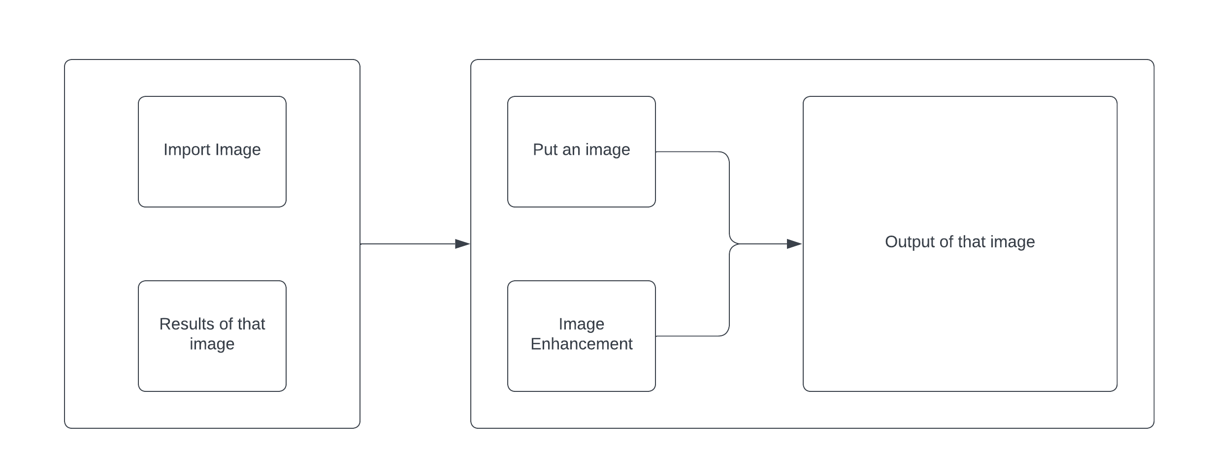
Implementation
Fig 3 : GUI Interface

Slide 31
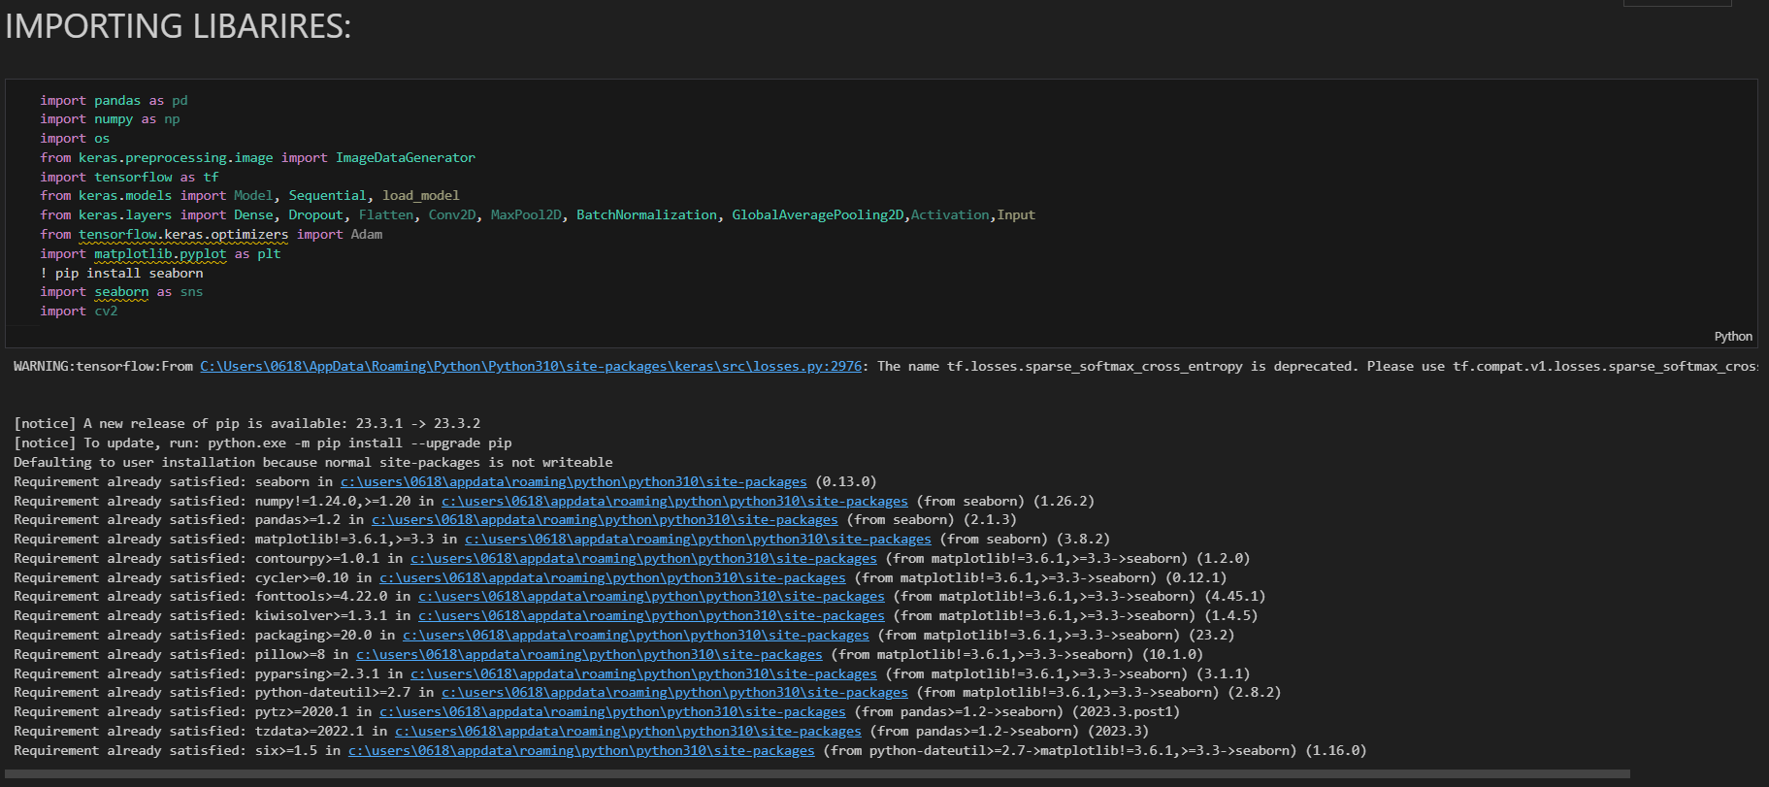
Implementation for MobileNet
Importing Libraries

Slide 32
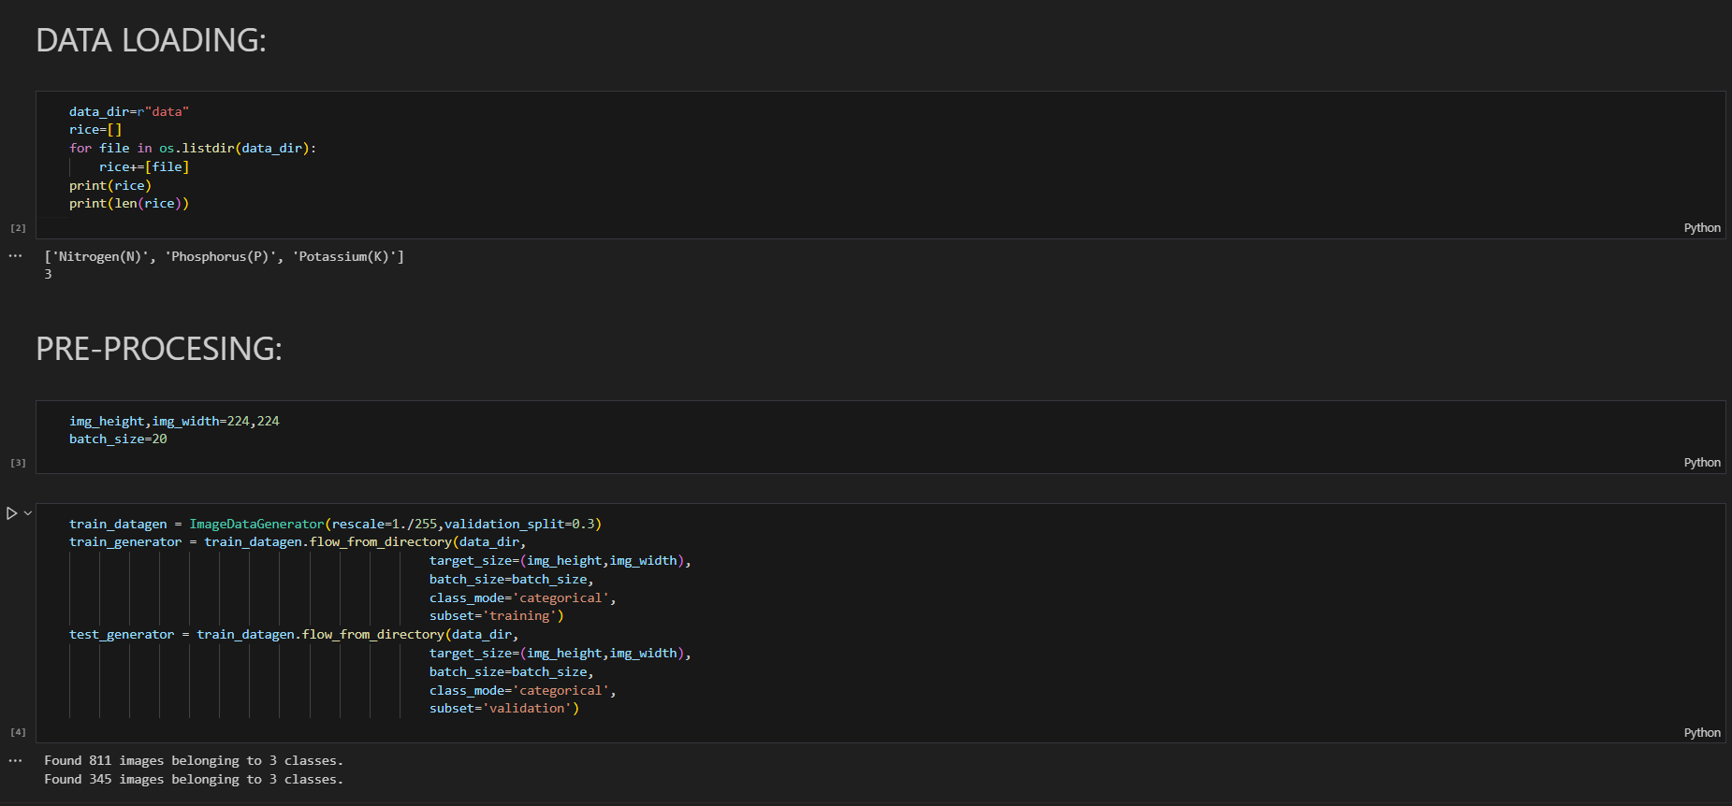
Implementation for MobileNet
Data Loading & Pre-processing

Slide 33
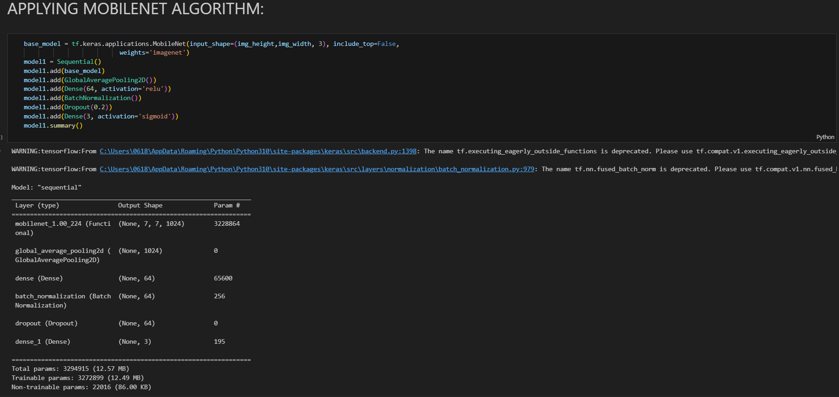
Implementation for MobileNet
Applying MobileNet Algorithm

Slide 34
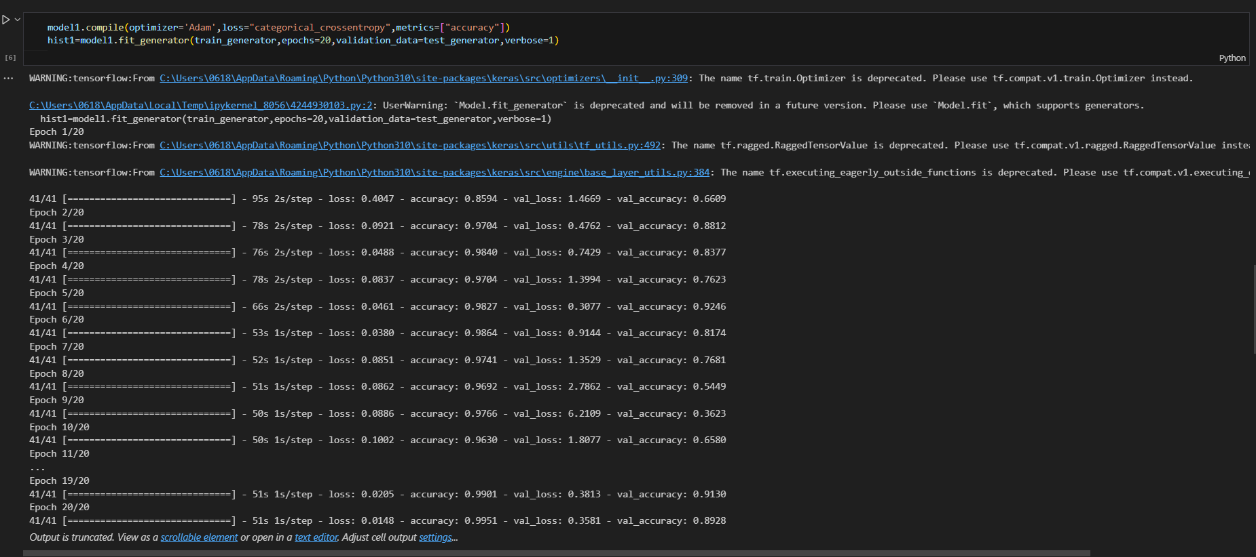
Implementation for MobileNet

Slide 35
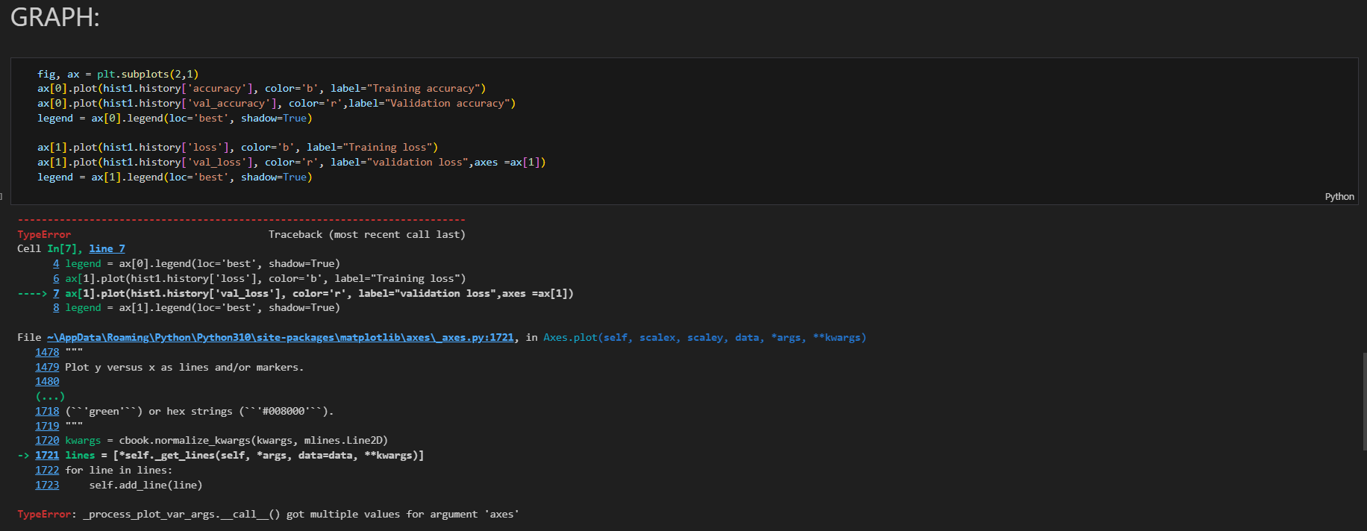
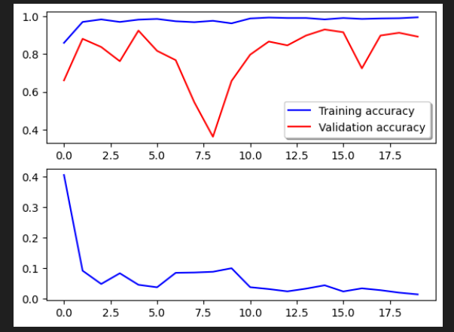
Implementation for MobileNet
Graphs

Slide 36
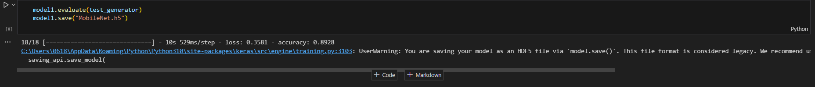
Implementation for MobileNet
Model Saving

Slide 37

Implementation for CNN
Importing Libraries

Slide 38
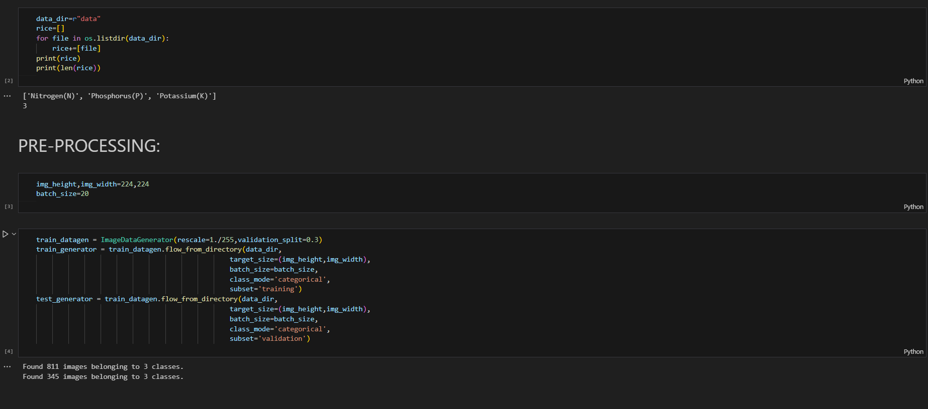
Implementation for CNN
Data Loading & Preprocessing

Slide 39
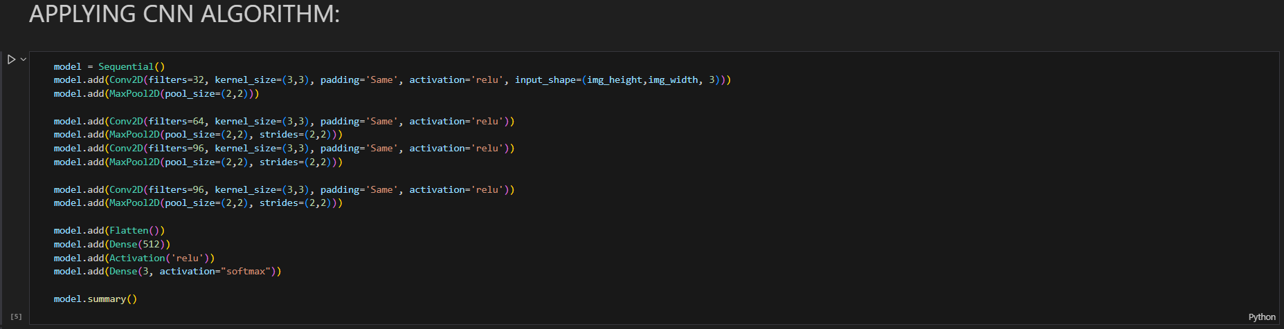
Implementation for CNN
Applying CNN Algorithm

Slide 40
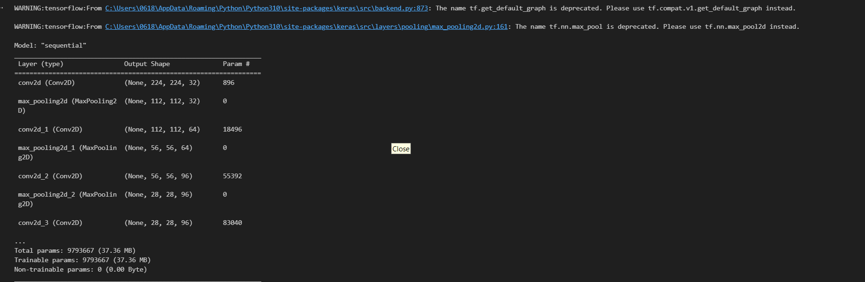
Implementation for CNN
Applying CNN Algorithm

Slide 41
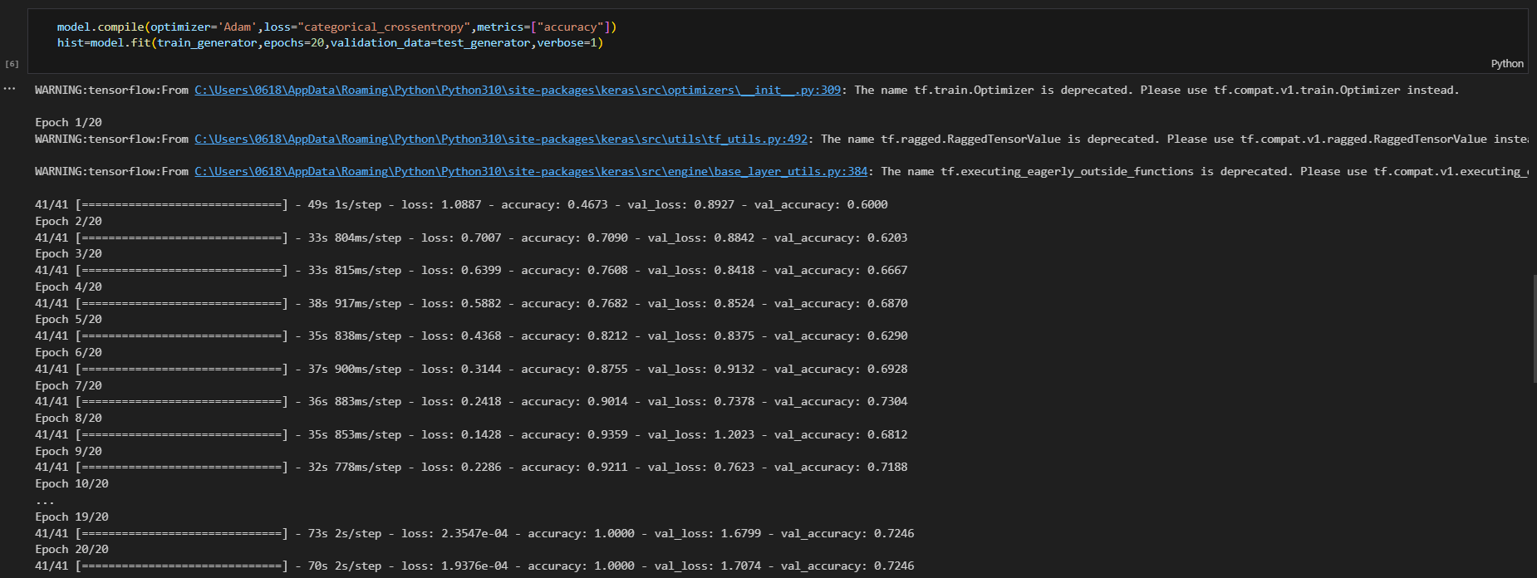
Implementation for CNN
Applying CNN Algorithm

Slide 42
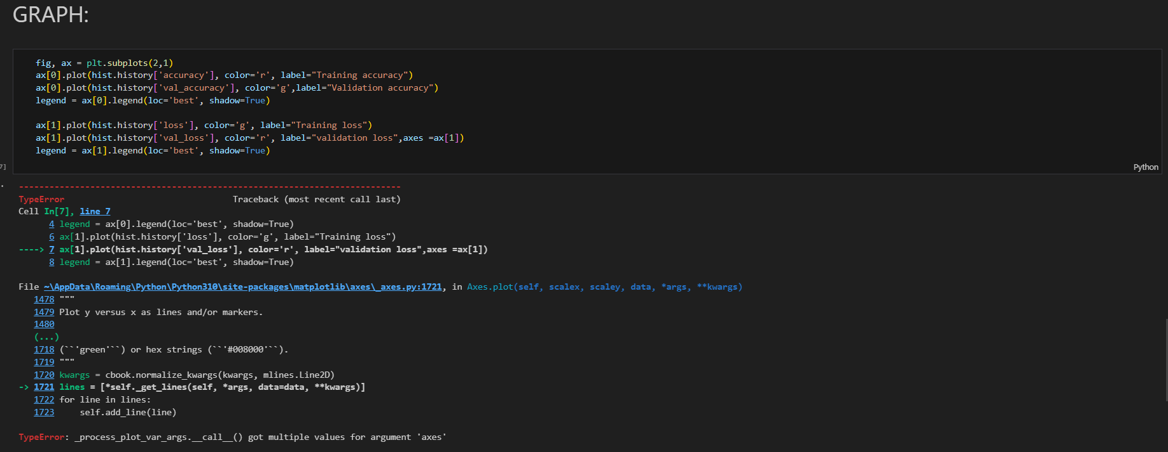
Implementation for CNN
Graphs

Slide 43
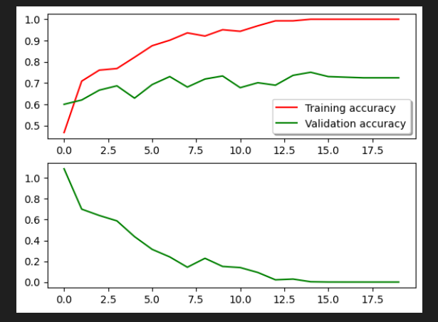
Implementation for CNN
Graphs

Slide 44
Implementation for CNN
Model Saving

Slide 45


Implementation- User Interface and Registration

Slide 46
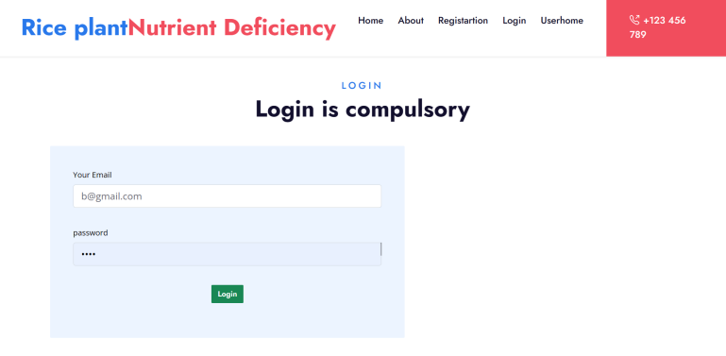
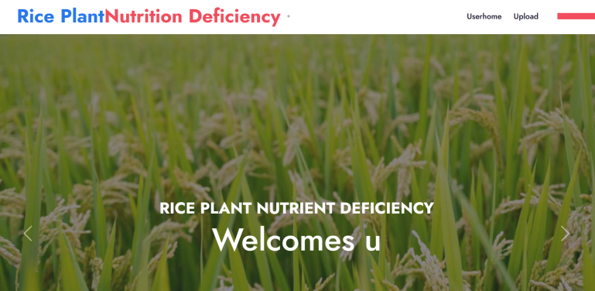
Implementation- User Login and Userhome

Slide 47

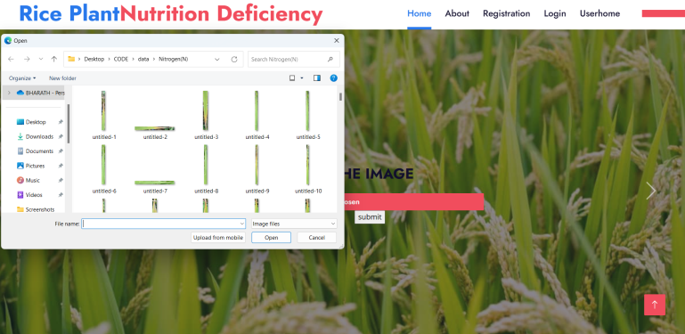
Implementation-Uploading the Image

Slide 48
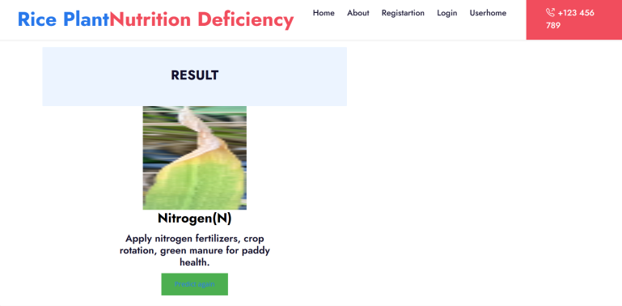
Implementation - Results

Slide 49
Conclusion
In conclusion, the nutrient deficiency detection system for paddy crops has demonstrated its efficacy in providing farmers with a robust tool for early diagnosis and proactive management of nutrient imbalances. The integration of image processing techniques and convolutional neural networks (CNNs) has proven successful in accurately classifying nutrient deficiencies, offering actionable insights to farmers. The user-friendly interface ensures accessibility, while the real-time analysis and historical trend tracking empower farmers to make informed decisions about their crop management practices. The system's notification capabilities, if implemented, further enhance its responsiveness to critical deficiencies, enabling timely corrective measures.The positive results obtained during the implementation phase validate the system's potential to significantly contribute to sustainable agriculture by optimizing nutrient utilization and improving crop yields. User feedback has been instrumental in refining the system, fostering a continuous improvement cycle.

Slide 50
Research Paper
Research Paper

Slide 51
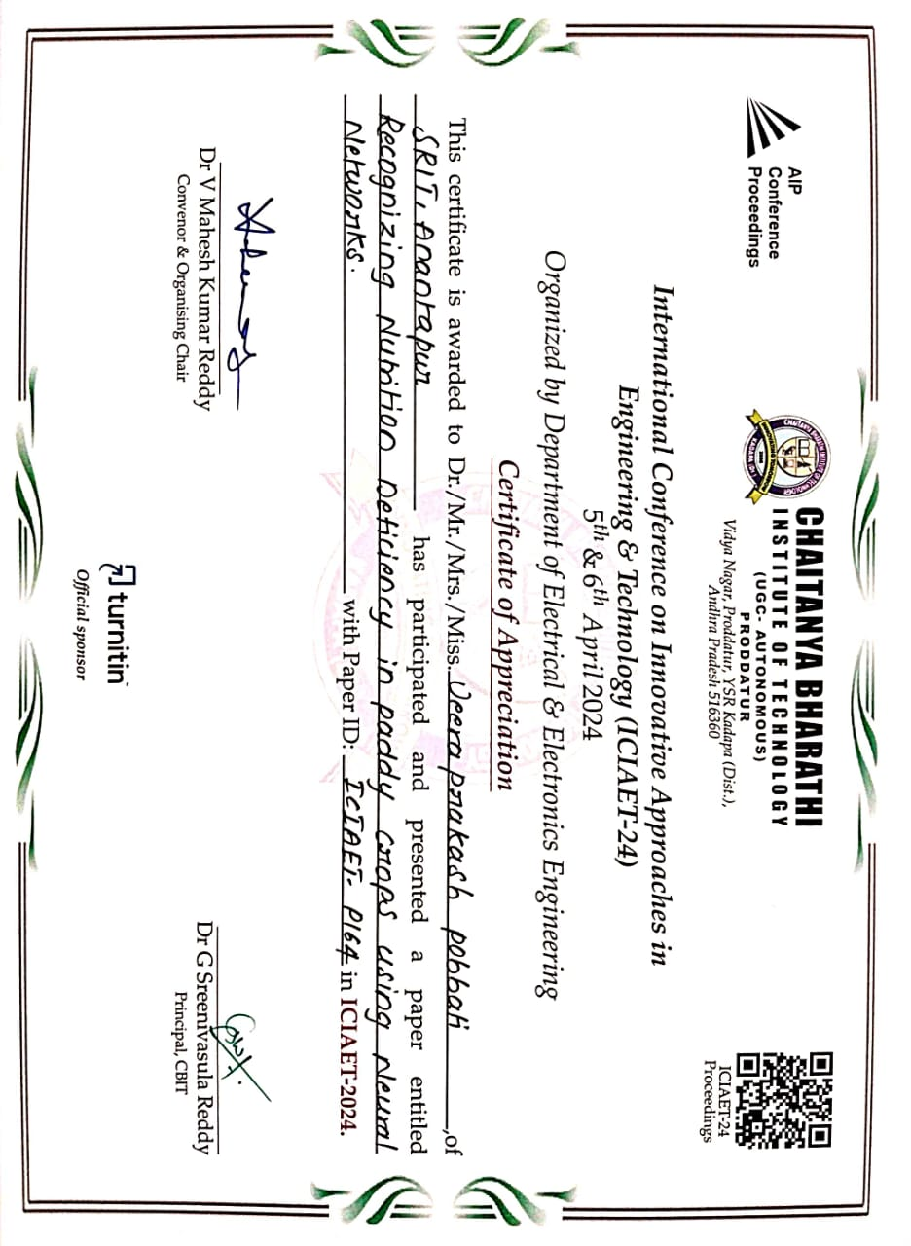
Certifications

Slide 52
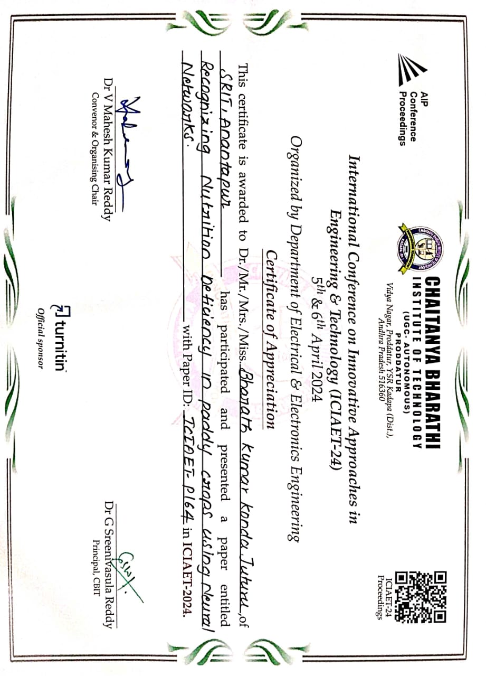
Certifications

Slide 53
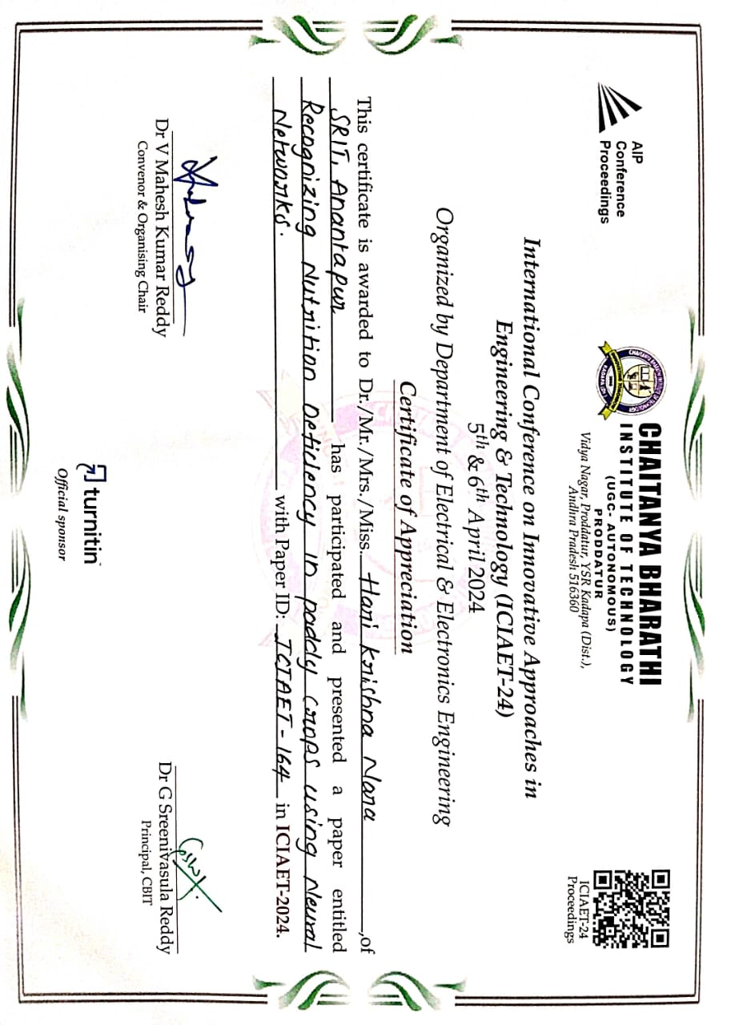
Certifications

Slide 54
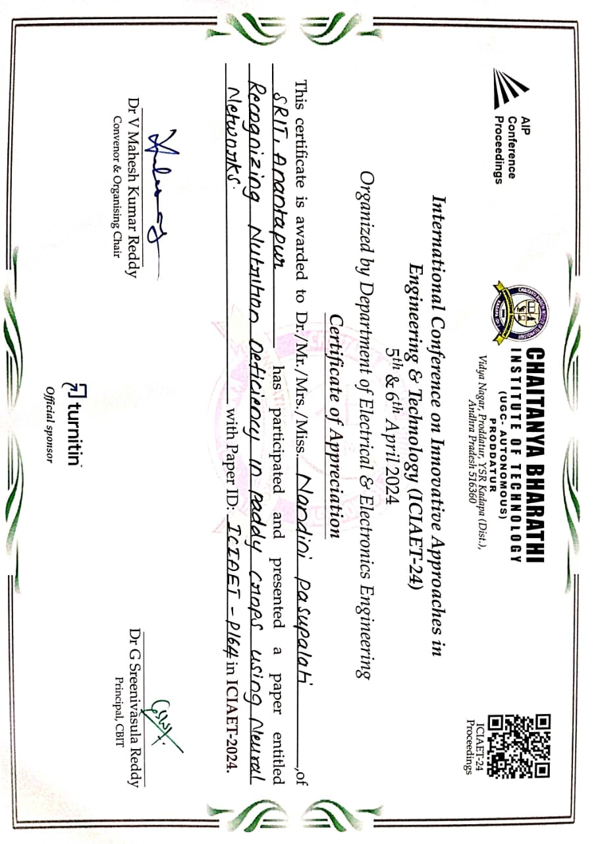
Certifications

Slide 55
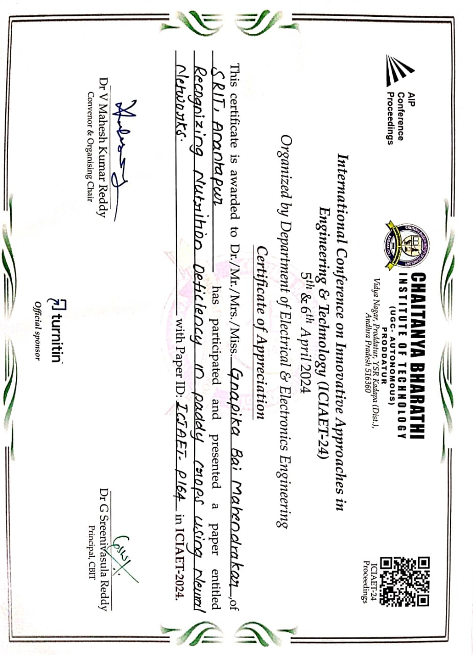
Certifications

Slide 56
References
[1].Amritha T, Gokulalakshmi T, Umamaheshwari P, T Rajasekar M.Tech, “Machine Learning Based Nutrient Deficiency Detection in Crops”, International Journal of Recent Technology and Engineering (IJRTE), ISSN: 2277-3878, Volume-8 Issue-6, March 2020.
[2].Lili Ayu Wulandhari, Alexander Agung Santoso Gunawan, Arie Qurania, Prihastuti Harsani, Triastinurmiatiningsih Ferdy Tarawan, Riska Fauzia Hermawan, “PLANT NUTRIENT DEFICIENCY DETECTION USING DEEP CONVOLUTIONAL NEURAL NETWORK”, ICIC Express Letters Volume 13, Number 10, October 2019.
[3].Lia Kamelia, Titik Khawa Binti Abdul Rahman, Hoga Saragih, Reni Haerani, “The Comprehensive Review on Detection of Macro Nutrients Deficiency in Plants Based on The Image Processing Technique”, Auckland University of Technology, December 2020.

Slide 57
References (Contd…)
[4].A. Pushpa Athisaya Sakila Rani, N. Suresh Singh, “Protecting the environment from pollution through early detection of infections on crops using the deep belief network in paddy”, Total Environment Research Themes 3-4 (2022) 100020.
[5].Ukrit watchareeruetai, Pavit Noinongyao, Chaiwat Wattanapaiboonsuk,
Puriwat Khantiviriya, Sutswat Duangsrisai, “Identification of plant Nutrient
Deficiencies Using Convolutional Neural Networks”, IEECON 2018
[6].Mr. Vijay J. Kadam, Prof. Dr. T.B. Mohite-Patil, “DETECTION OF
NUTRIENT DEFICIENCIES IN CROPS USING SUPPORT VECTOR
MACHINE (SVM)”, International Research Journal of Engineering and
Technology (IRJET), Volume: 09 Issue: 08 | Aug 2022.

Slide 58
GitHub Link
204G1A0520/CSE-2020-24-Batch-A16 (github.com)

Slide 59
Thank You!!!

